Slide 1

MC9510- Modelling in Operations Research Poisson process
T. Mayooran,
Department of Interdisciplinary Studies,
Faculty of Engineering,
University of Jaffna.
Email: mayooran@eng.jfn.ac.lk

Slide 2
Content of This Lecture
Goals:
Introduction to Principles for Reasoning about Process operation research.
Things covered in this lecture:
Introduction to Poisson Process

Slide 3
Poisson process
to describe arrivals and services.
properties of the Poisson process.

Slide 4
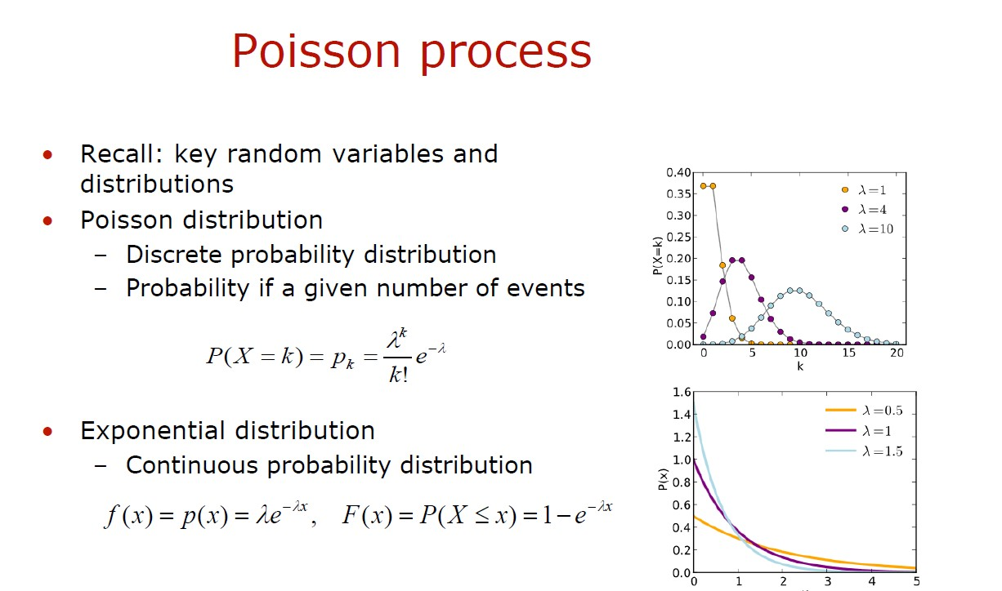

Slide 5
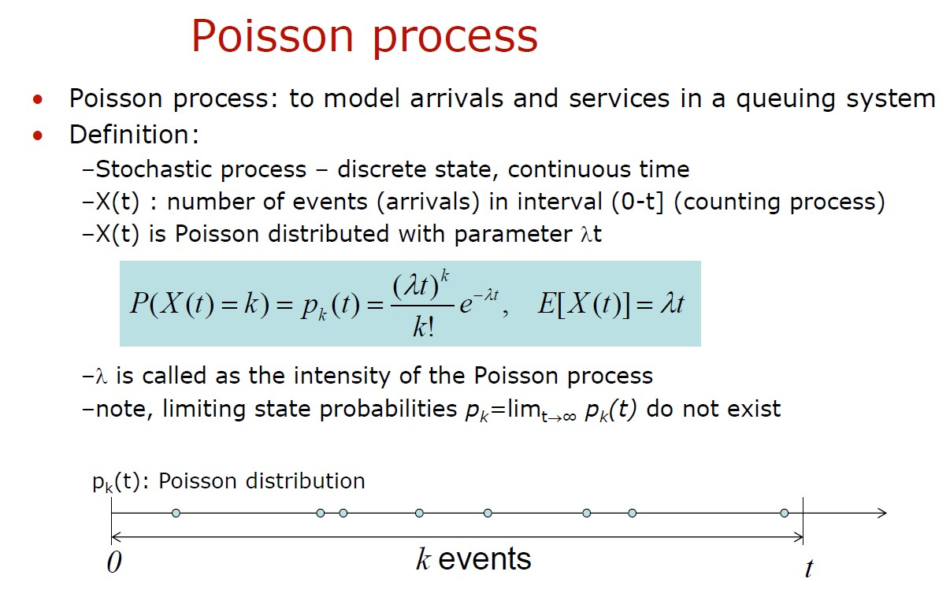

Slide 6
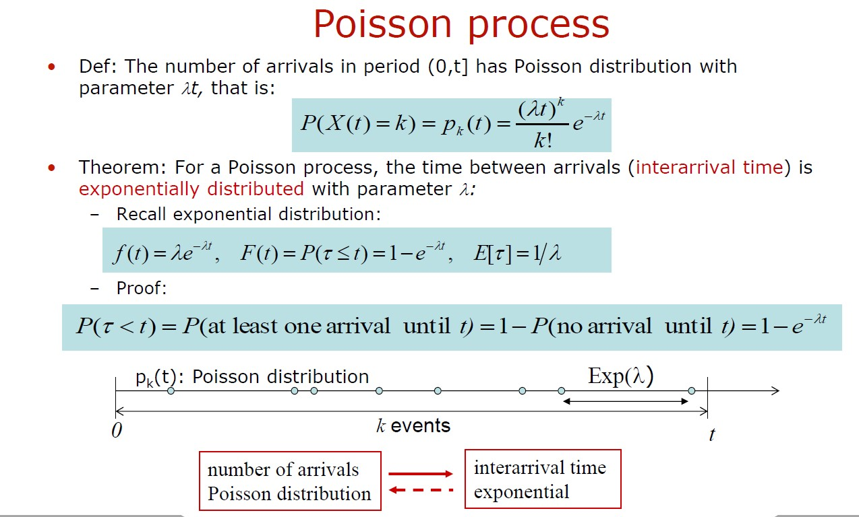

Slide 7
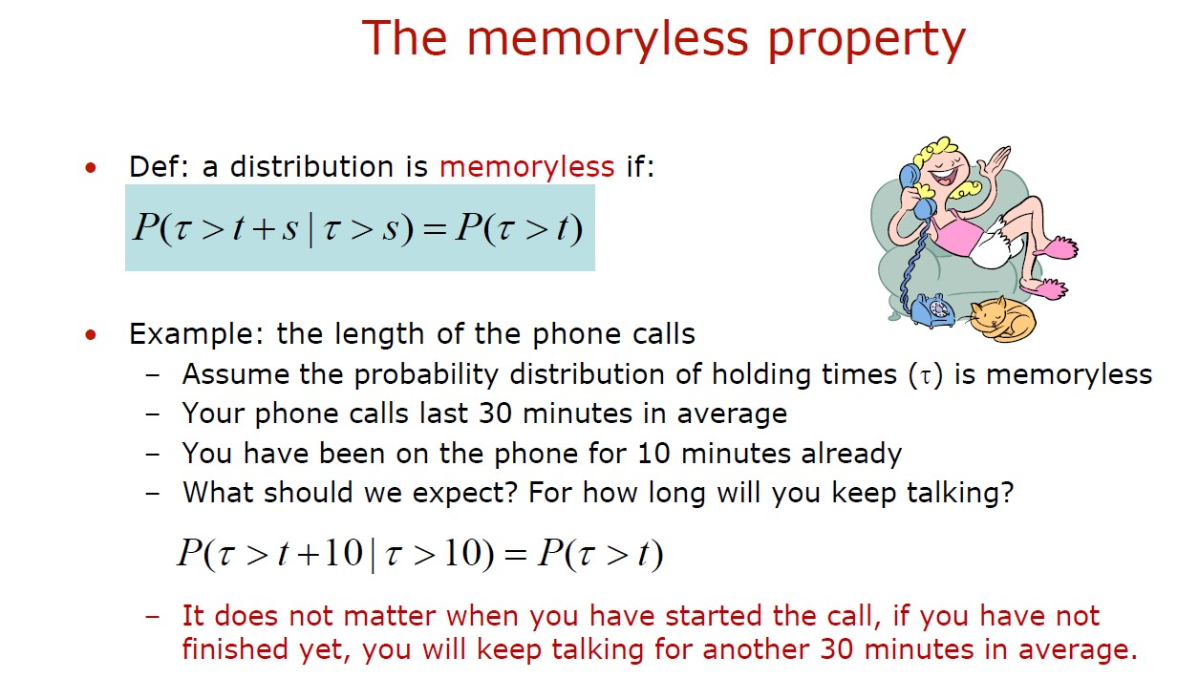

Slide 8
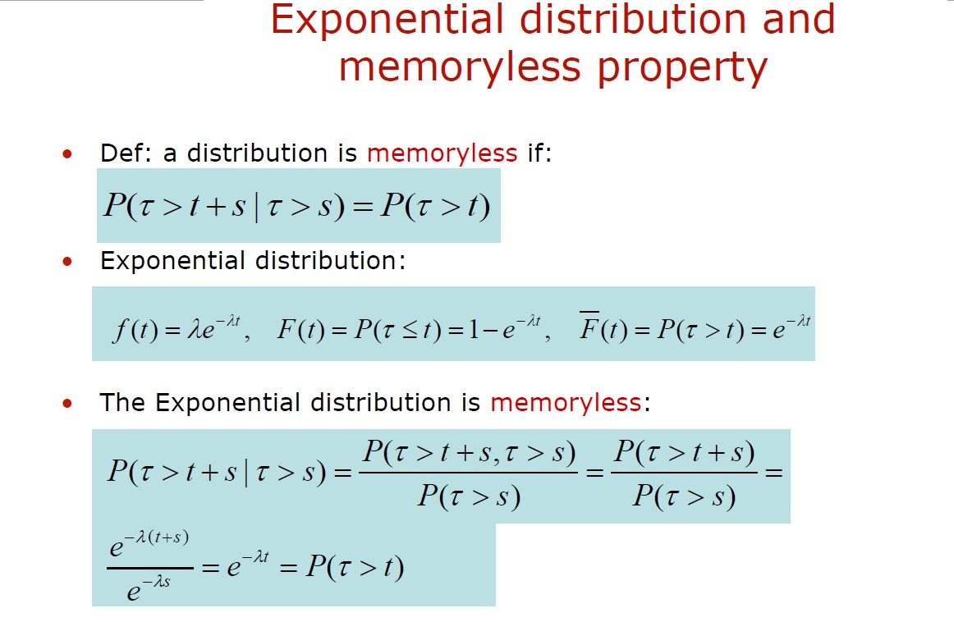

Slide 9
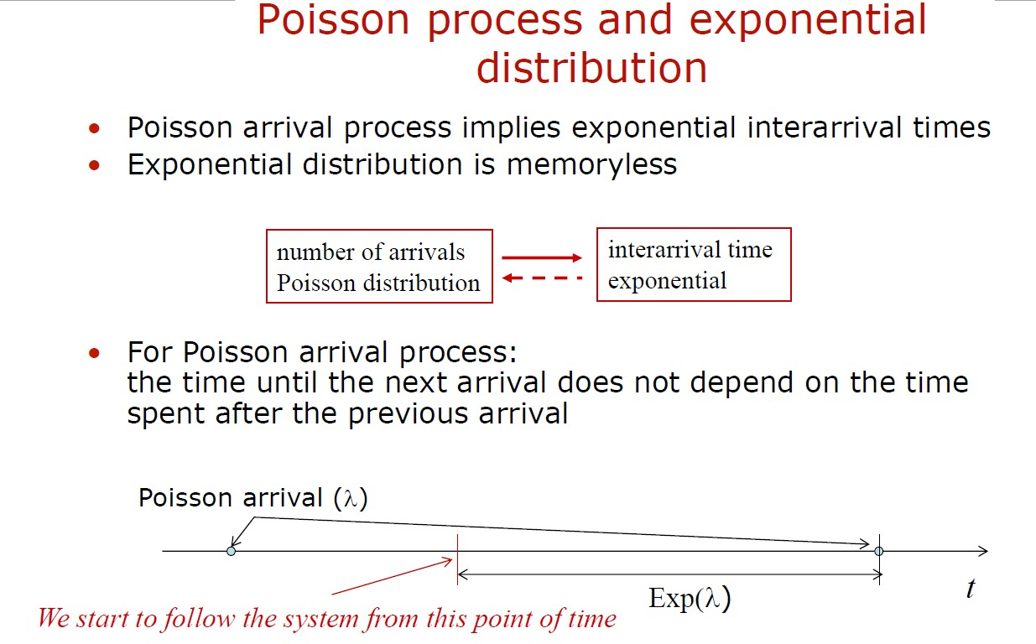

Slide 10
Practice Problems – Poisson Process
Problem 1: A call center receives an average of 5 calls per minute. Assuming the calls arrive according to a Poisson process, calculate the probability that the call center receives exactly 8 calls in a 2-minute interval.
Problem 2: A manufacturing plant experiences, on average, 2 machine failures per day. Assuming machine failures follow a Poisson process, calculate the probability that exactly 4 machine failures occur in a 24-hour period.
Problem 3: A retail store receives an average of 10 customers per hour. Assuming customer arrivals follow a Poisson process, calculate the probability that the store has at least 15 customers in a 2-hour period.

Slide 11
Problem 4: In a computer network, the average number of packets arriving per second is 3. Assuming packet arrivals follow a Poisson process, what is the probability that no packets arrive within a 1-second interval?
Problem 5: A car rental agency receives an average of 2 reservations per hour. Assuming reservations follow a Poisson process, calculate the probability that exactly 3 reservations are made in a 90-minute interval.

Slide 12
Solution for Problem 1:
In a Poisson process, the probability of receiving a certain number of events (calls in this case) in a fixed interval is given by the Poisson distribution formula:
P(X = k) = (λ^k * e^(-λ)) / k!
Where:
P(X = k) is the probability of receiving exactly k events in the interval.
λ is the average rate of events in the interval.
e is the base of the natural logarithm (approximately 2.71828).
k is the number of events.
Given that the call center receives an average of 5 calls per minute, and we are looking for the probability of receiving exactly 8 calls in a 2-minute interval, we need to adjust the average rate (λ) for the 2-minute interval:
Average rate (λ) = 5 calls/minute * 2 minutes = 10 calls
Now, plug the values into the Poisson distribution formula:
P(X = 8) = (10^8 * e^(-10)) / 8!
Calculating this:
P(X = 8) ≈ 0.112599
So, the probability that the call center receives exactly 8 calls in a 2-minute interval is approximately 0.112599, or about 11.26%.

Slide 13
Problems 2, 3, 4 and 5 are very similar problems, so workout yourself!

Slide 14
Practice Problems – Memory less property
Problem 1:
Suppose the time between phone calls received at a call center follows an exponential distribution with a mean of 10 minutes. What is the probability that the next call will arrive within the next 5 minutes, given that no calls have been received in the past 20 minutes?
Problem 2:
The lifetime of a certain electronic component follows an exponential distribution with a mean of 1000 hours. What is the probability that the component will last for more than 500 additional hours, given that it has already been functioning for 2000 hours?

Slide 15
Problem 3:
The time between arrivals of cars at a drive-thru restaurant follows an exponential distribution with a mean of 3 minutes. What is the probability that the next car will arrive within the next 2 minutes, given that the previous car arrived 5 minutes ago?
Problem 4:
The time between equipment failures in a manufacturing plant follows an exponential distribution with a mean time between failures (MTBF) of 500 hours. The plant has been operating for 1000 hours without experiencing any failures. What is the probability that the next failure will occur within the next 200 hours?

Slide 16
Solution for Problem 1:
The exponential distribution possesses the memoryless property, which states that the probability of an event occurring within a given time frame is independent of how much time has already passed. This property allows us to simplify the calculation when dealing with time intervals.
In this case, the property implies that the probability of receiving a call within the next 5 minutes is the same as the probability of receiving a call within the first 5 minutes of operation, regardless of the past 20 minutes of no calls.
Given the exponential distribution with a mean of 10 minutes, the rate (λ) is 1 / 10 = 0.1 calls per minute.
The probability of receiving a call within the next 5 minutes is:
P(call within 5 minutes) = 1 - e^(-λ * 5)
P(call within 5 minutes) = 1 - e^(-0.1 * 5)
P(call within 5 minutes) = 1 - e^(-0.5)
P(call within 5 minutes) ≈ 0.39347
So, using the memoryless property, the probability that the next call will arrive within the next 5 minutes, given that no calls have been received in the past 20 minutes, is approximately 0.39347 or about 39.35%.

Slide 17
Problems 2, 3 and 4 are very similar problems, so workout yourself!

Slide 18
Compound Poisson Process

Slide 19
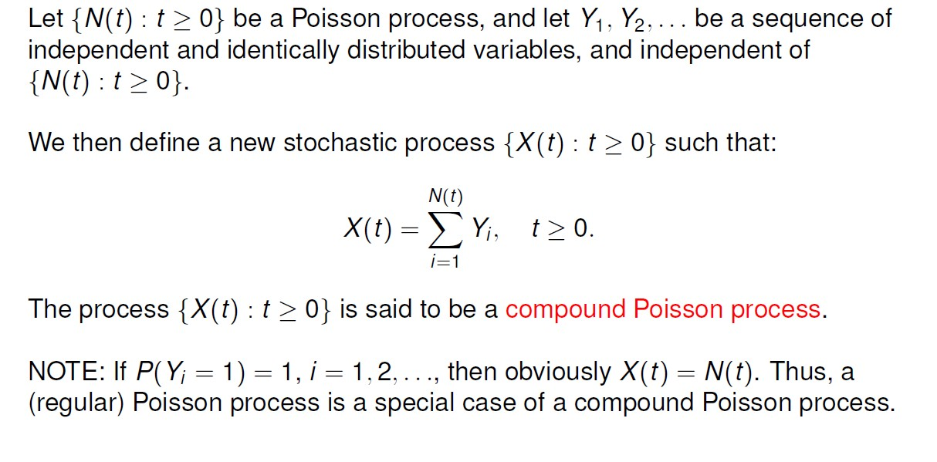
Compound Poisson Process

Slide 20
Example:
In a telecommunications network, the number of errors that occur in a given time interval follows a Poisson process with a rate of 5 errors per minute. Each error requires an average of 2 minutes to be fixed. What is the average number of errors present in a 30-minute interval?
Solution:
The compound Poisson process represents the total number of events occurring in a given time interval. In this case, the number of errors in a 30-minute interval follows a compound Poisson distribution.
The average number of errors in a 30-minute interval can be calculated as the product of the rate of the Poisson process (5 errors per minute) and the duration of the interval (30 minutes).
Therefore:
Average number of errors in a 30-minute interval = λ * t = 5 * 30 = 150
Hence, the average number of errors present in a 30-minute interval is 150.

Slide 21


Don’t hesitate to contact us if you have any questions about this course’s teaching contents. Also, don’t forget to check out the course page and Microsoft Team folder,
course page Link: https://mayooran1987.github.io/MC9510/
Course page’s QR code
Microsoft Team folder

